Slide 1
Stock Price Trend Forecasting
Using Supervised learning and Sentiment analysis.

Slide 2
Problem Statement
The aim of the project is to examine a number of forecasting techniques to predict future stock returns made on past returns and news indicators. We do this by applying supervised learning methods for stock price forecasting by interpreting the seemingly chaotic market data.

Slide 3
Motivation
The fluctuation of stock market is violent and there are many complicated
financial indicators. However, the advancement in technology, provides an
opportunity to gain steady fortune from stock market and also can help experts
to find out the most informative indicators to make better prediction. The
prediction of the market value is of paramount importance to help in maximizing
the profit of stock option purchase while keeping the risk low.

Slide 4
Models to be used
LINEAR REGRESSION
SVM SVR

Slide 5
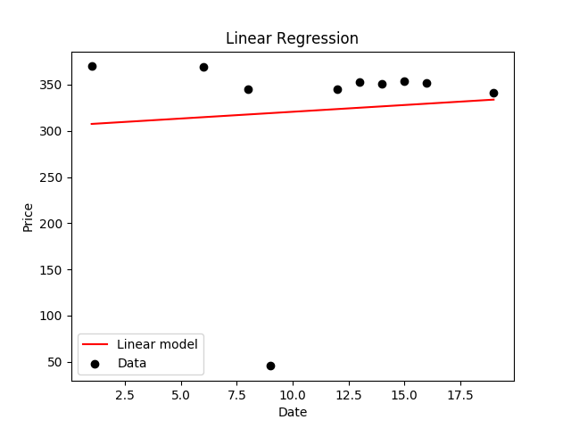

Slide 6
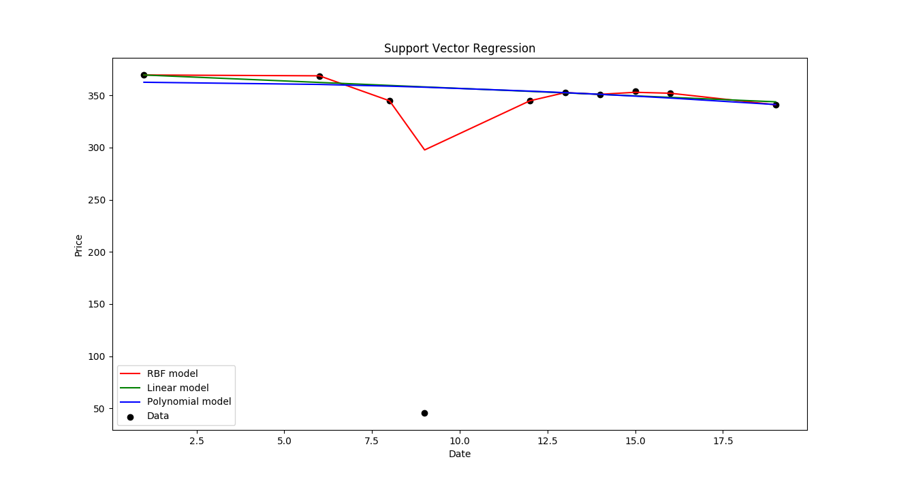

Slide 7
79%
This is the Maximum accuracy of SVR which is the most of all the models. It gets more accurate if it is used to predict a long term data.

Slide 8

Twitter sentiment score as a new feature
A Non quantifiable information

Slide 9
Twitter Sentiment Analysis
Social Media plays an important role in predicting the stock market return values So, one more feature of sentiment analysis is very important.
Twitter’s Daily Sentiment Score for each company based upon the user’s tweets about that particular company and also the tweets on that company’s page.

Slide 10
The Website
We have made a website which shows the data of various companies.
It shows the price of stocks for different dates and also compares accuracy for different companies.
Tweet sentiment analysis is also done which shows how much positive , negative and neutral news comes for a particular company and changes are shown in the price accordingly.

Slide 11
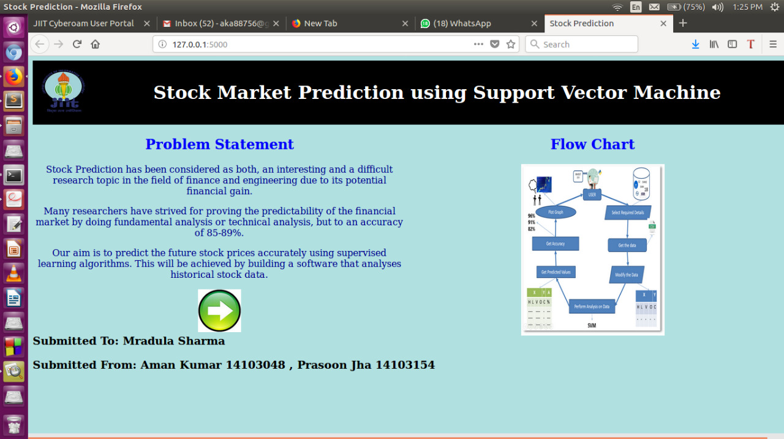

Slide 12
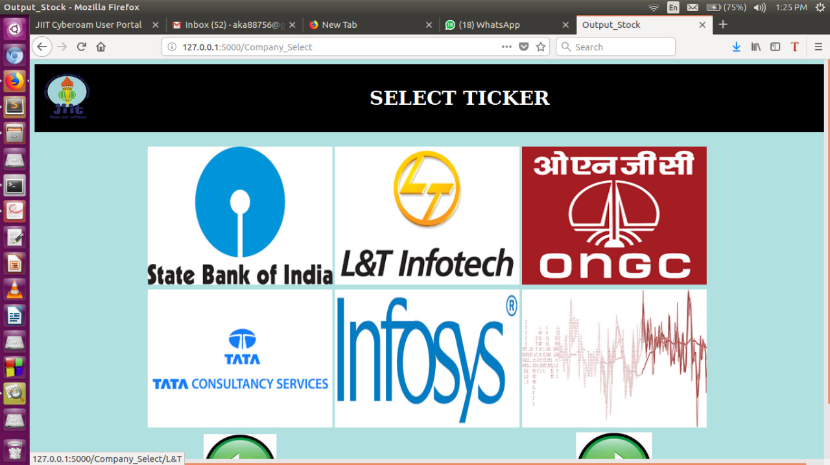

Slide 13
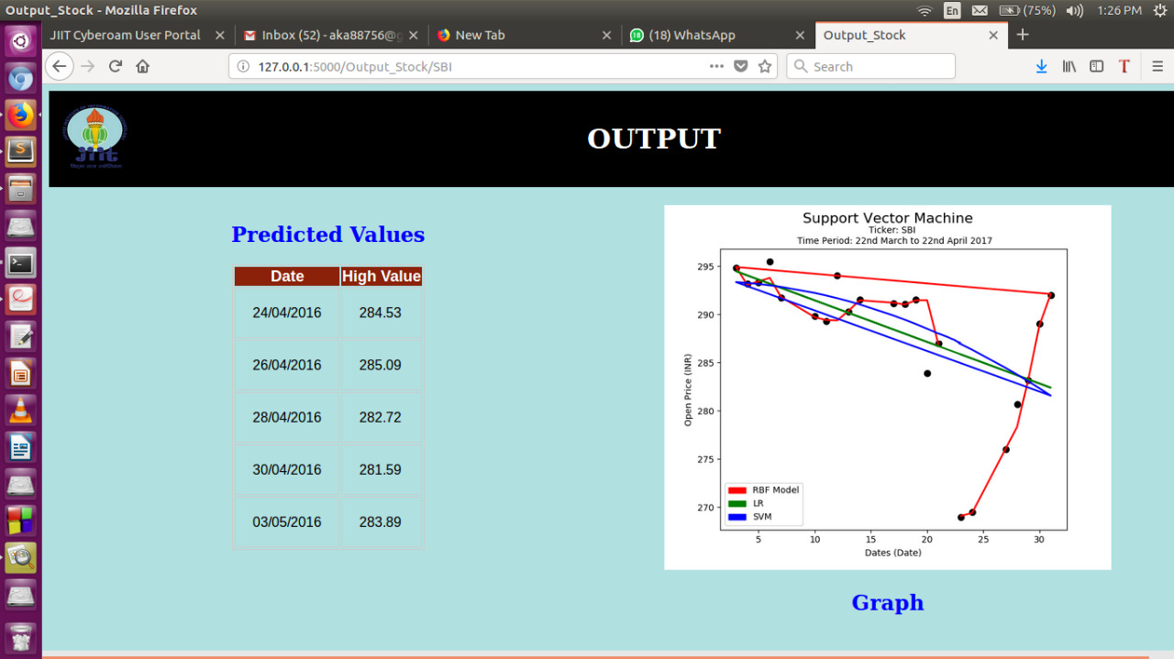

Slide 14
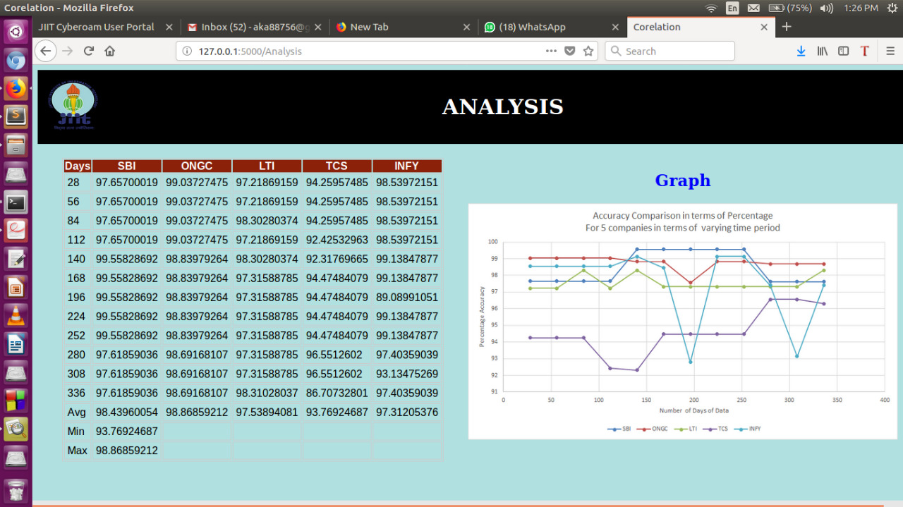

Slide 15
That’s All folks..

